Slide 1
Sellstate Leadership Summit
2015

Slide 2
Homes.com & Sellstate
Chris Sorrenti
National Broker Consultant

Slide 3
What is it all about?
How to leverage it for MORE Business?
How do you, as a Broker, use it to your advantage?

Slide 4
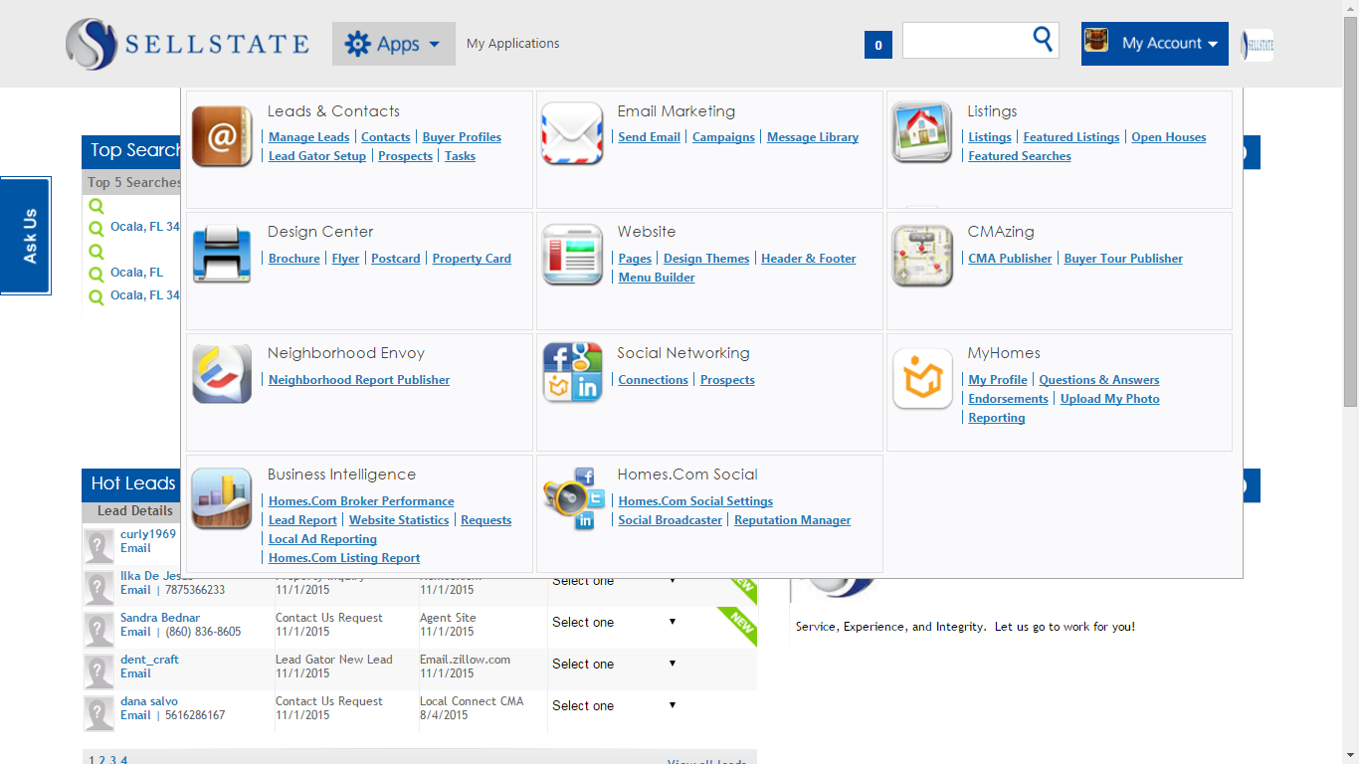
What’s in the Box...

Slide 5
What’s in the Box...
CRM
Lead Manager
Drip Email Campaigns
Listing Manager and Editor
Design Center
CMAzing
Neighborhood Report Tool
Profile Manager
Social Media Tools including a Social Broadcaster
Website Manager App

Slide 6
Leverage for your Brokerage and Agents to get MORE Listings and MORE Leads
Preferred Listings
Listing Videos
Mobile Responsive/IDX Websites

Slide 7
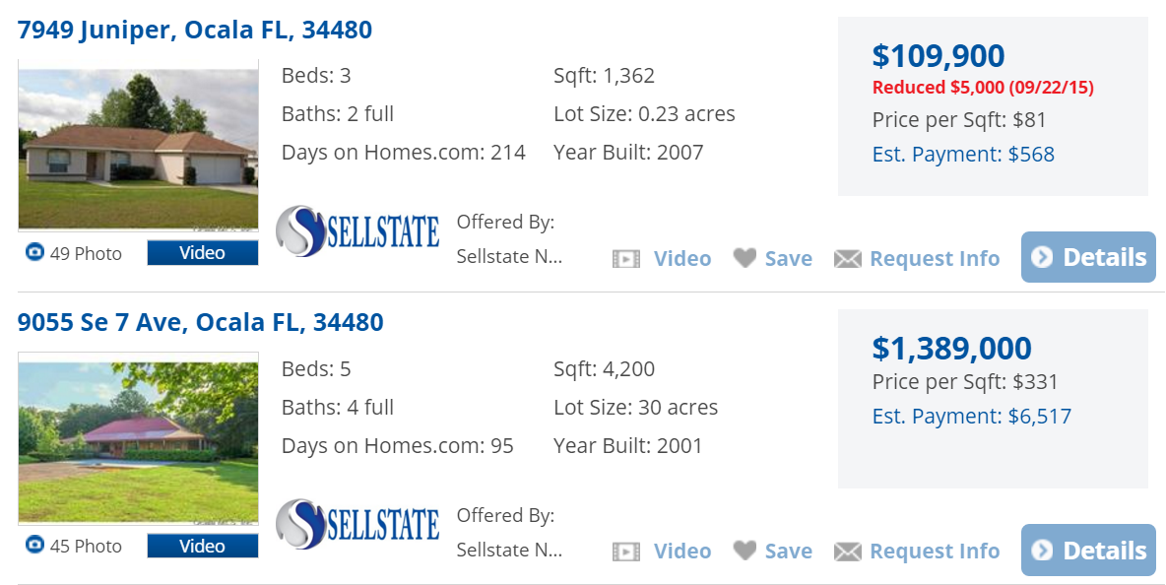
Preferred Listings

Slide 8
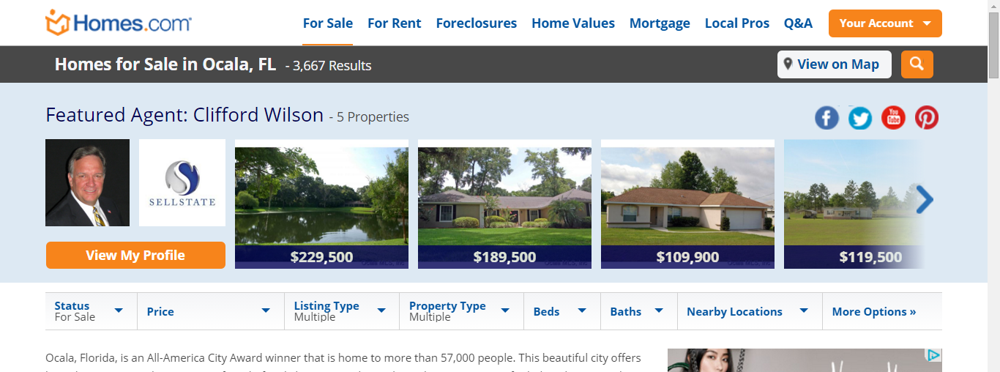
August we launched the NEW “Local Ads”
Stay on TOP (mobile included)

Slide 9
February we launched “Local Connect”
Buyer Leads by Zip Code

Slide 10
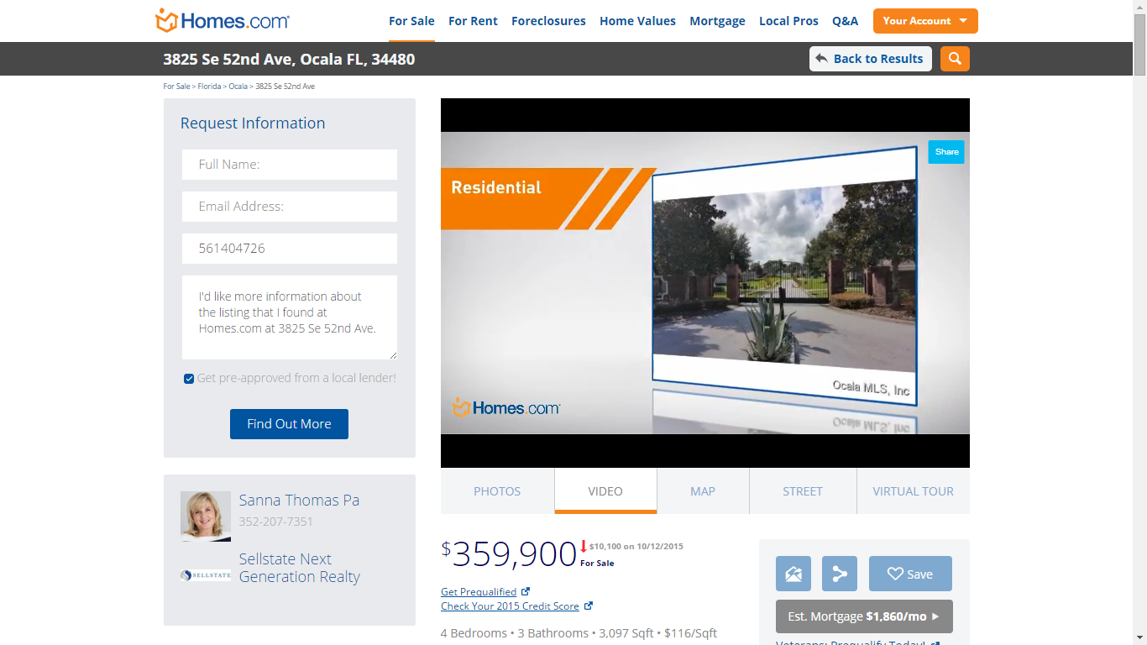
Listing Videos

Slide 11
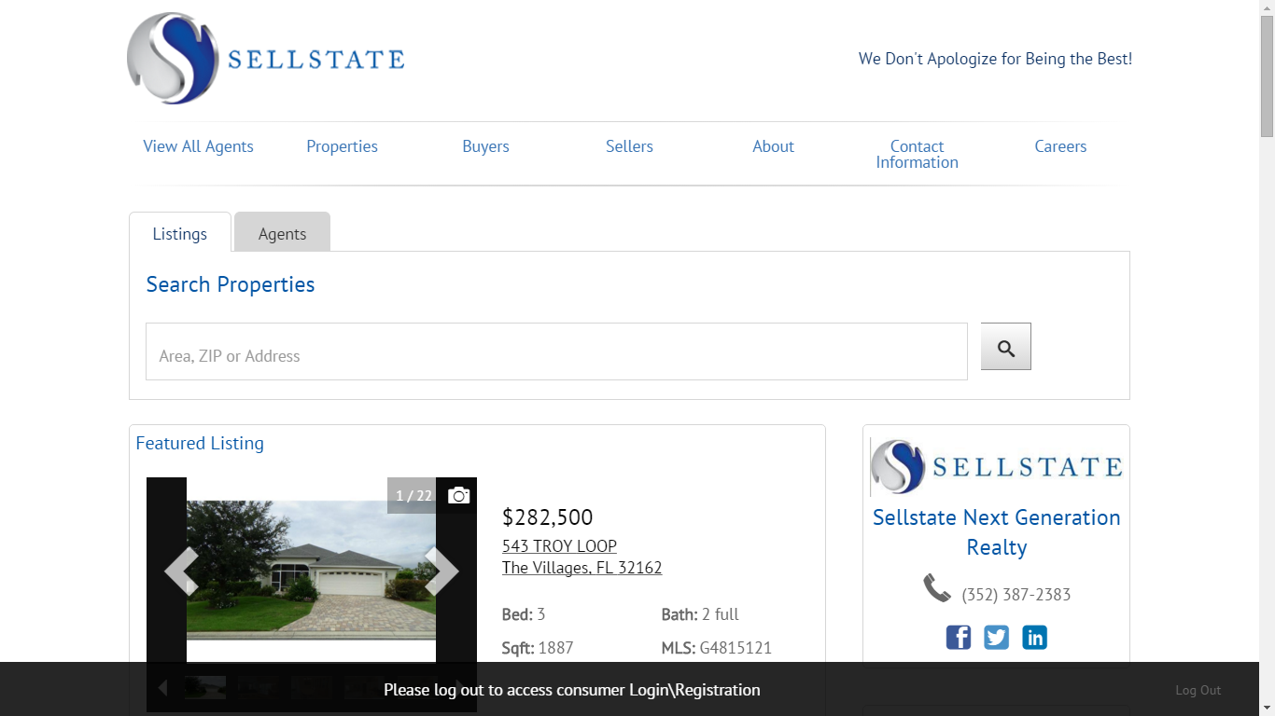
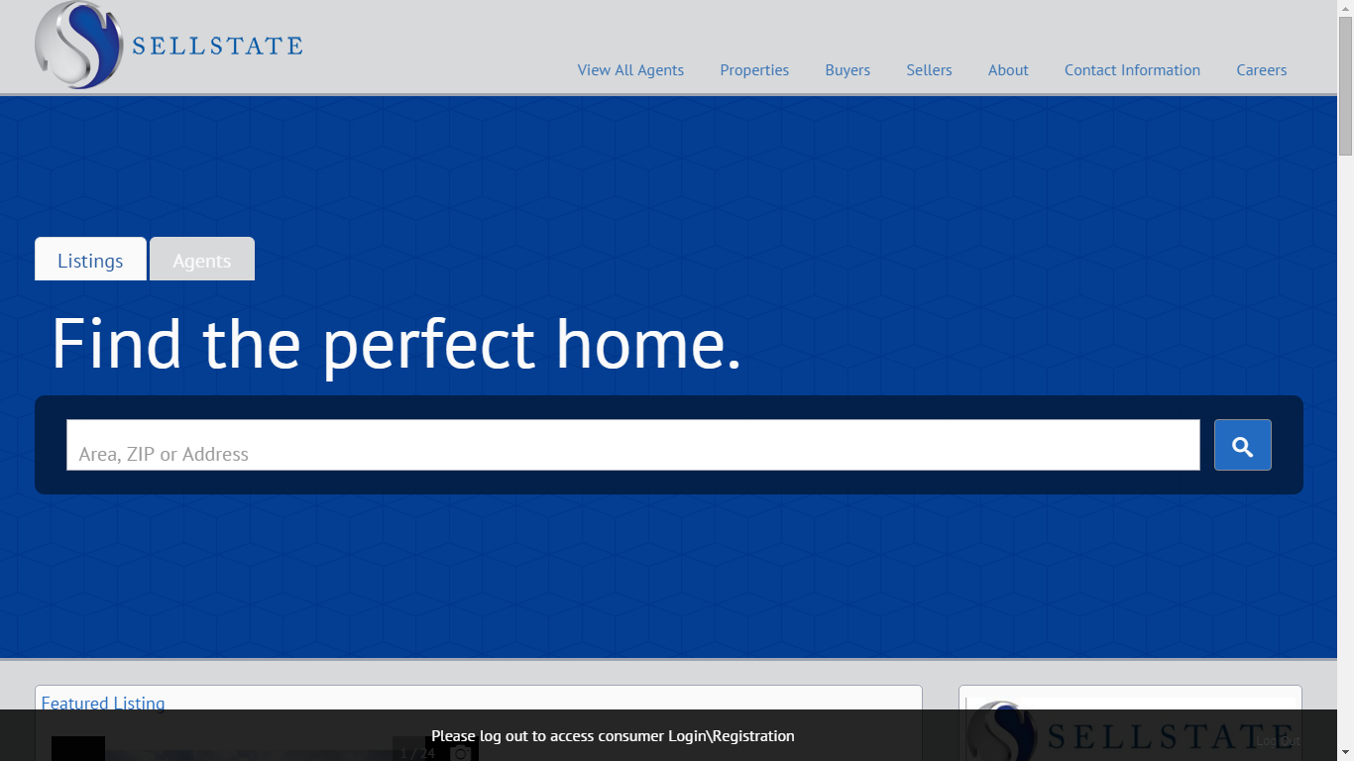
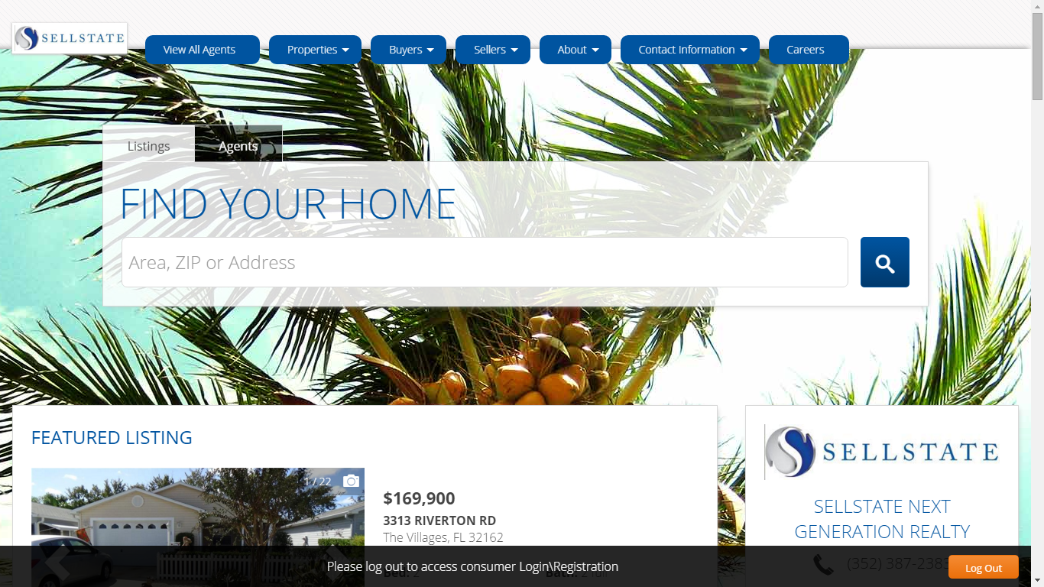
Mobile Responsive/IDX Websites

Slide 12
Use the tools to advance your Brokerage
Doing more, produces more
Brokerage and Agents can stay on top of their business
Single Sign-on saves time and in Real Estate time is money
Stay relevant in the market with technology
Become that consultative Brokerage/Agent using the included neighborhood data and the reporting tools
Fill in the blank...

Slide 13
How do I Recruit and Retain those Top Agents?
We have solutions for them as well, offered at discounted rates for working with Sellstate

Slide 14
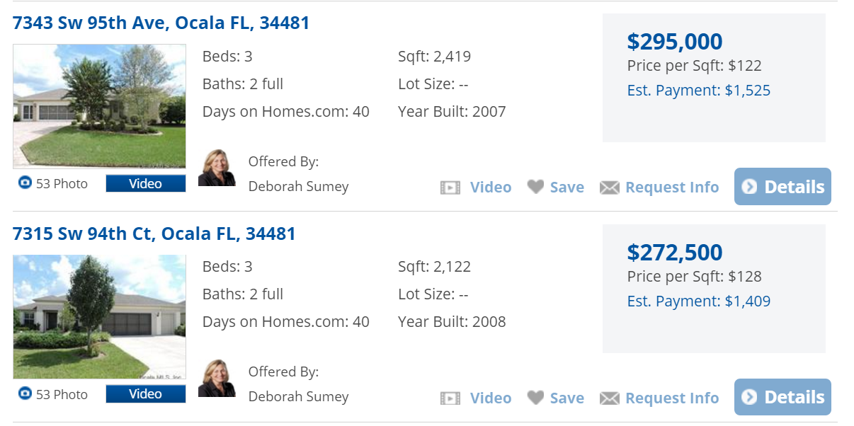
Agent Preferred Listings

Slide 15
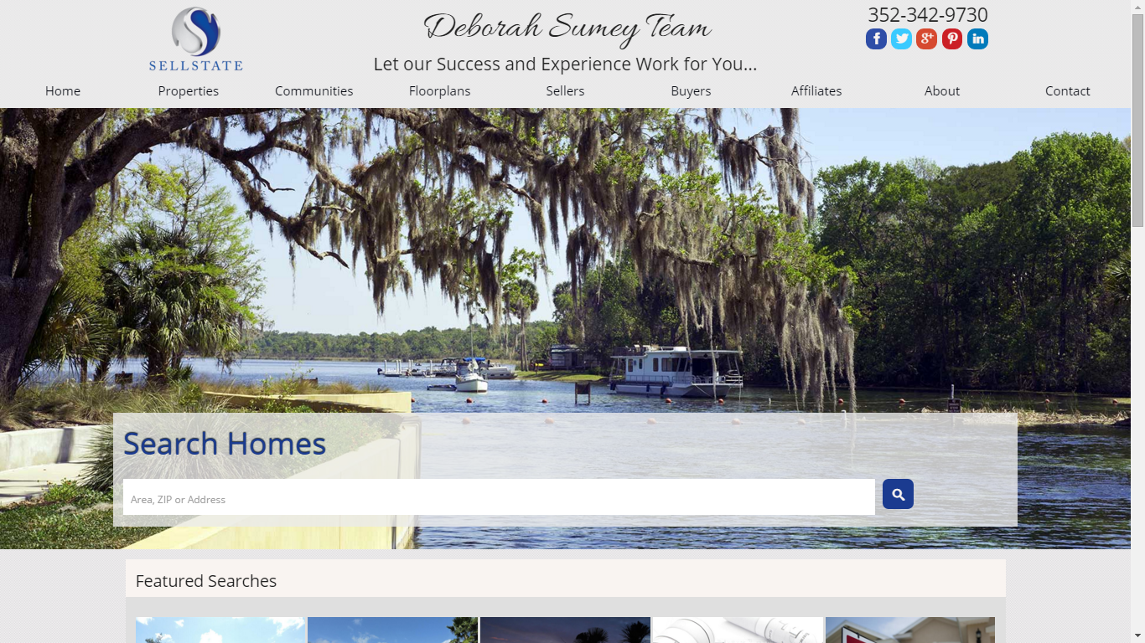
Custom Designed Websites

Slide 16
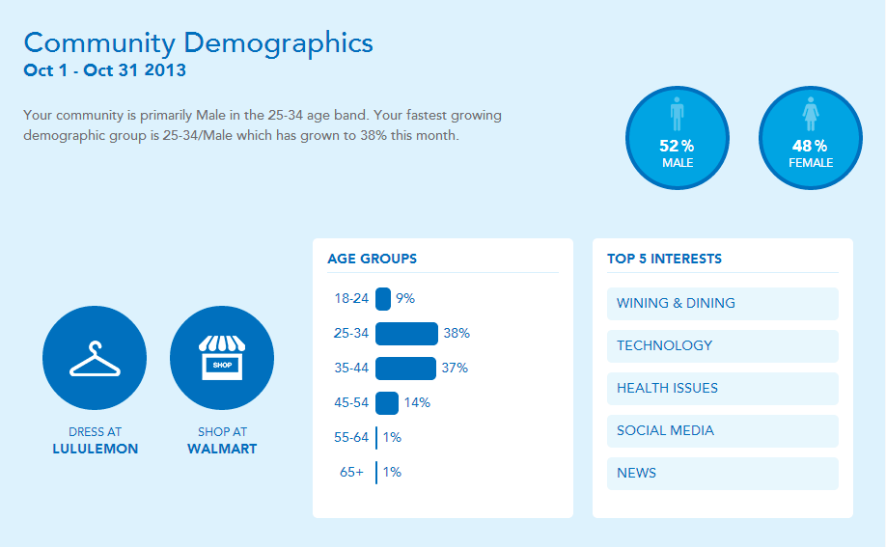
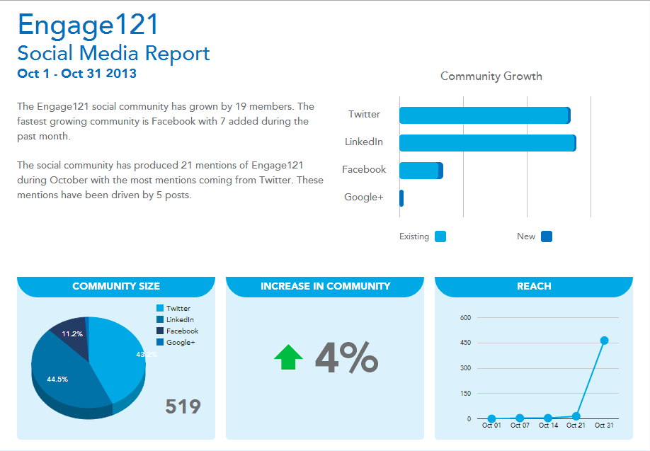
Social Media Dominance

Slide 17
Recruiting, Retention, and Revenue
Relevance - Show your Agents how well supported they are technology-wise
Give them the RIGHT tools to get the job done
Save them $$
Agents that have tools like these through their Broker, more often than not, STAY
More business, More Leads, More $$

Slide 18
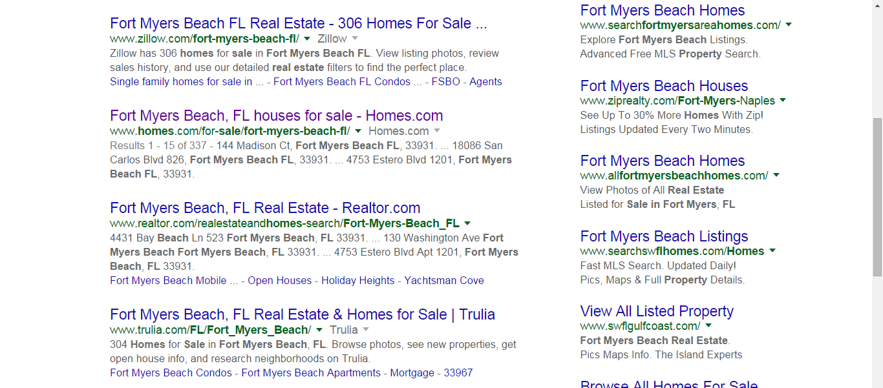
Homes.com is on the MOVE
Our search rankings have improved tremendously

Slide 19
Homes.com is on the MOVE
Our back-end is going mobile

Slide 20
But I don’t even know how to use it!

Slide 21
But I don’t even know how to use it!
That’s okay cause you are with Homes.com

Slide 22
But I don’t even know how to use it!
Every Broker gets a Broker Consultant Tech Rep
Every Agent has access to our Customer Service Line
We have Videos on Demand for all the back-end applications
We have detailed step-by-step instructions with images for all the back-end applications
We offer many weekly FREE Webinars to learn more about the back-end
BUT WAIT…...there’s MORE!!

Slide 23
But I don’t even know how to use it!
Homes.com also allows for office visit trainings
for you and your Agents
(check with your local rep for availability)
At this Summit we will be giving out training videos using branded Sellstate back-ends to show form, fit and function of all the applications.

Slide 24
I want to know more. Who do I reach out to?
Chris Sorrenti, National Broker Consultant
561-981-5988 chris.sorrenti@homes.com
Dave Fricker, Director of Broker Services
561-981-9747 david.fricker@homes.com

