Slide 1
The sellstate system
prepared for:
Client Name
Real Estate’s Most Innovative Franchise Model
presenter
email
Presenter Name
Presenter Email Address

Slide 2
Sellstate
The History
New national franchise
Efficient design
Optimized for agents and brokers
Empowers agents

Slide 3
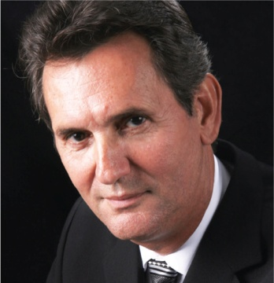
The Founders
Arthur Darmanin, Chief Operating Officer
Over 35 years experience in real estate
Managed first real estate company 2 years into career
Built independent to largest office in entire area
Member of O.R.E.A. Faculty of Education
Executive Member of one of North America’s largest real estate companies

Slide 4
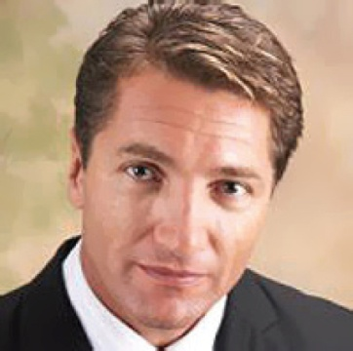
The Founders
Neil Cresswell, President
Over 25 years experience in real estate
Top ranked real estate agent in North America
Single-handedly outperformed entire brokerages
Franchisor for one of the top real estate companies in North America
National real estate trainer

Slide 5
The best of all models
INTER-DEPENDENT
MODEL
DEPENDENT
MODEL
INDEPENDENT
MODEL
DEPENDENT
INTERDEPENDENT
INDEPENDENT
INTERDEPENDENT
Associate is dependent on the company; associates are replaceable.
Associates have an interdependent relationship with their company.
Associates are independent; Associates have a landlord/tenant relationship with their company.
An Interdependent Model that incorporates the best of all models and adds monthly revenue sharing for an immediate reward and partnership environment.
100% Real Estate Companies
Traditional Real Estate Company
Growth Focused
Team Focused
Associate Focused
Broker Focused
Associate & Broker Focused
Associate & Broker Focused
Give your rebellious Associates their freedom
Control Associate
Company Vision Served
Success Breeds Success
Broker Brand Strategies
Associate Brand Strategies
Associates Brand Strategies
Associate/Company Brand Strategies
Associates Overpay Management
Associates pay a reasonable fee
Associates do not pay for things that they do not use
Associates pay a reasonable fee
Low Risk/Low Take
Low Risk/ High Take
High Risk/High Take
Low Risk/ High Take

Slide 6
C.P. Technology (Centralized Processing)
A Better Way to Pay Commissions
Efficient
Quick turnaround
Direct deposit of commissions
Direct deposit of AAD
Timely distribution of your 1099
Save you time
Provide you with freedom

Slide 7
Attracting Top Agents
Home of the Top Producers
Top agents demand high commission
Designed to attract the best
Aggressive Commission Structure
AAD Program
Better culture

Slide 8
Agent Asset Development (AAD) Program
Freedom | Work or Play, Still Earn Income
Nothing like it in the industry
Earn additional income
5% sponsoring bonus
Earn financial independence

Slide 9
Agent Asset Development (AAD) Program
Security | Earn Extra Income for The Things That Matter
Have peace of mind
Disability insurance
Health care
Earn even if you don’t have a closing

Slide 10
Agent Asset Development (AAD) Program
Retirement | Have The Opportunity to Retire and Enjoy Life
AAD monthly payout average is around $1,000
The program is vested
Finally have a retirement plan
Enjoy your rewards from your career

Slide 11
Sellstate Power Suite
The Power to Control Your Business From Anywhere in The World

Slide 12
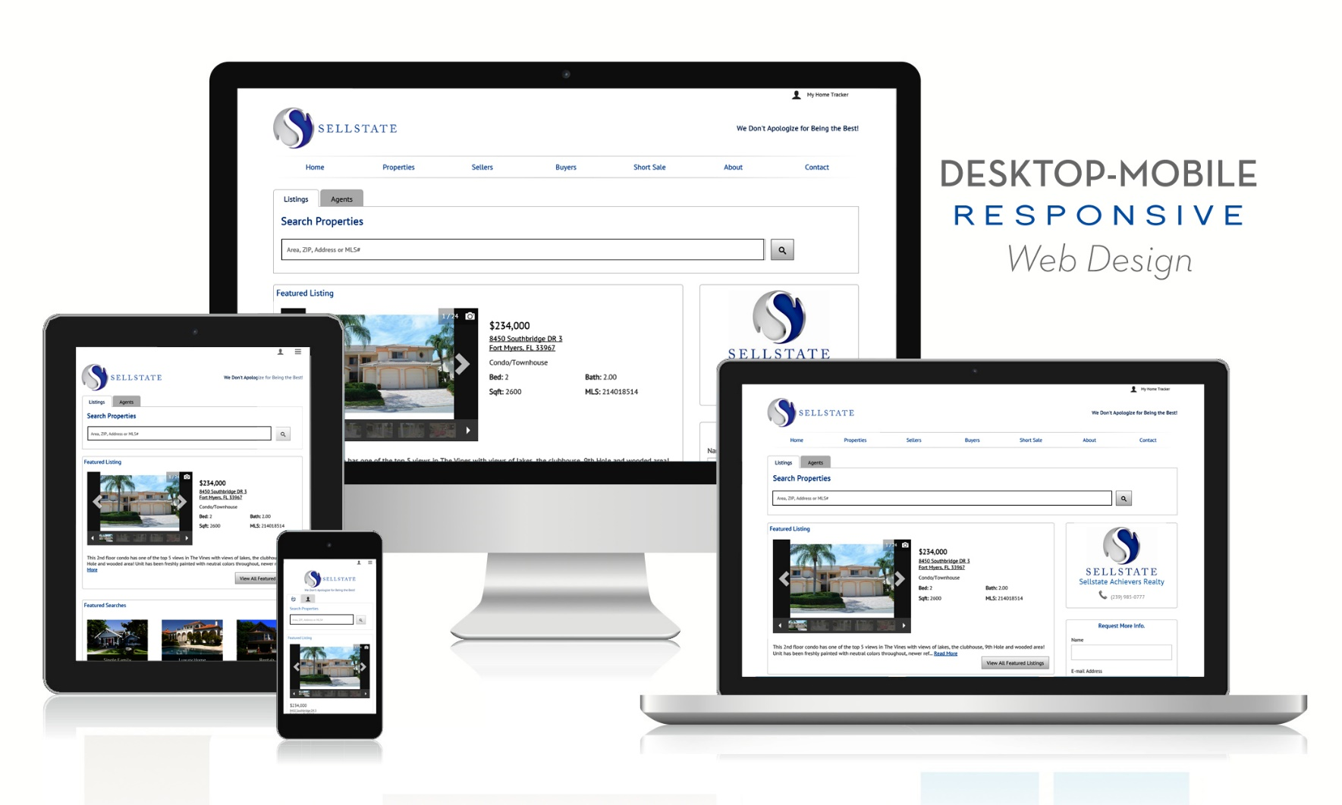
Power Suite
Globalize Your Business Through Your Mobile Responsive Website

Slide 13
Power Suite Apps
Technology That Takes Your Business to The Next Level

Slide 14
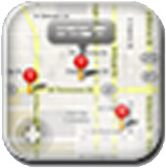
Power Suite APP Breakdown
Everything You Need in One Single Login
Lead Management
Custom Listing Enhancements
Email Marketing
CMA and Buyer Tours
Neighborhood Demographics
IDX Website
Full Marketing Center
Custom Design Center
Social Broadcasting
Social Media Integration
My Homes Connection
Business Intelligence

Slide 15
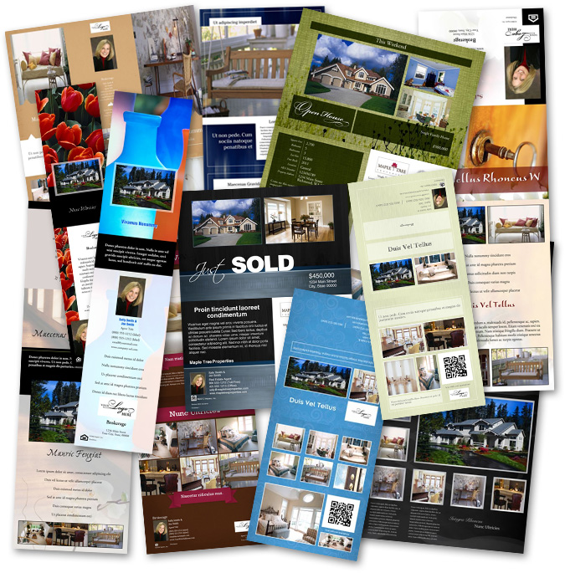
Power Suite Marketing Studios
The Power of Professional Marketing at Your Fingertips
Tremendous marketing campaigns
Custom designs
Professional level
Send directly to printer

Slide 16
Power Suite Zillow Enhancements
The Power to Automate Lead Generation

Slide 17
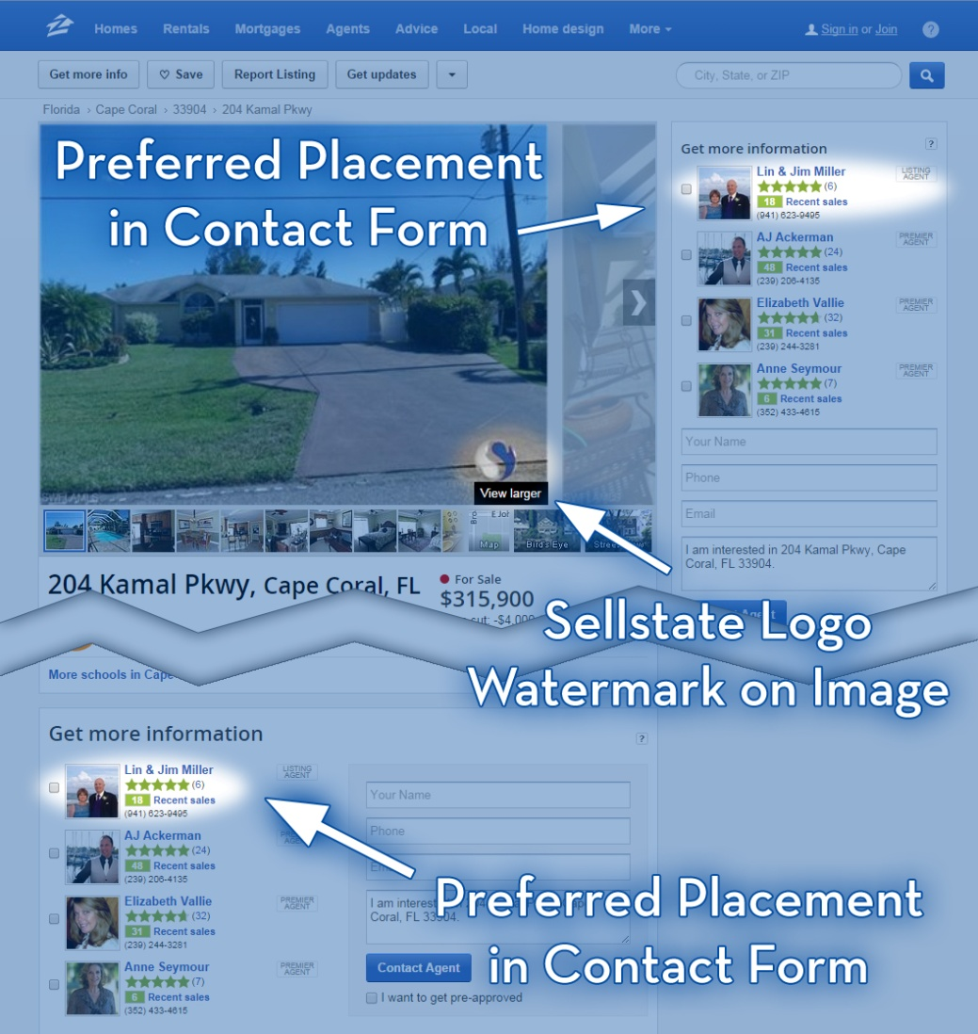
Power Suite Zillow Enhancements
Strategic Alliance with Zillow, the World’s Number 1 Home Search Site

Slide 18
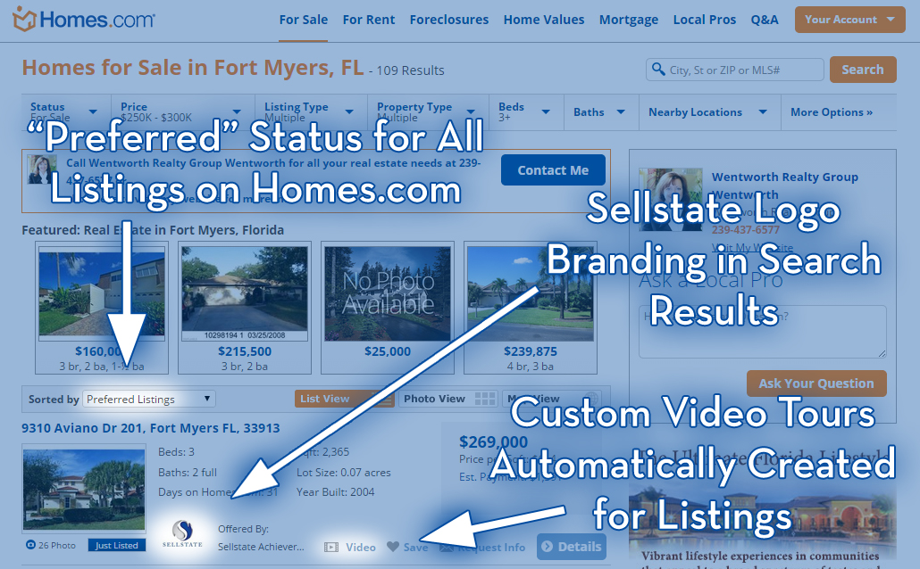
Power Suite Homes.com Enhancements
The Power to Automate Lead Generation

Slide 19
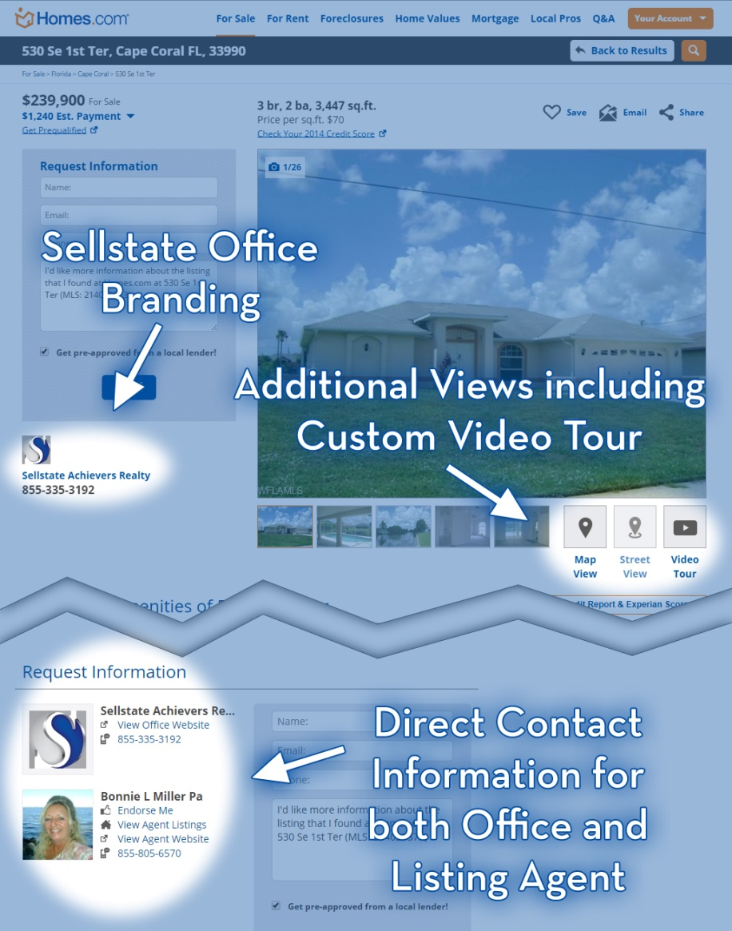
Power Suite Homes.com Enhancements
Strategic Alliance with Homes.com, the Best Quality Lead Site

Slide 20
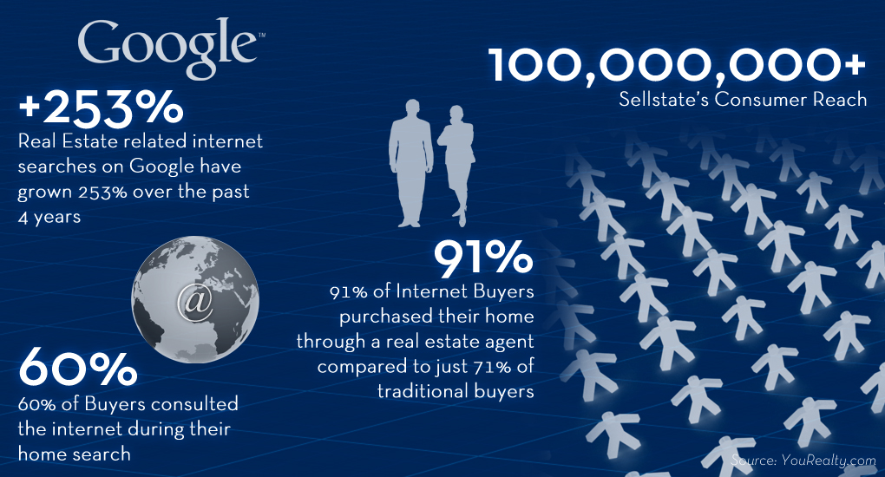
Power Suite Consumer Reach
Custom Enhanced Listings Reaching Over 100,000,000+ Visitors

Slide 21
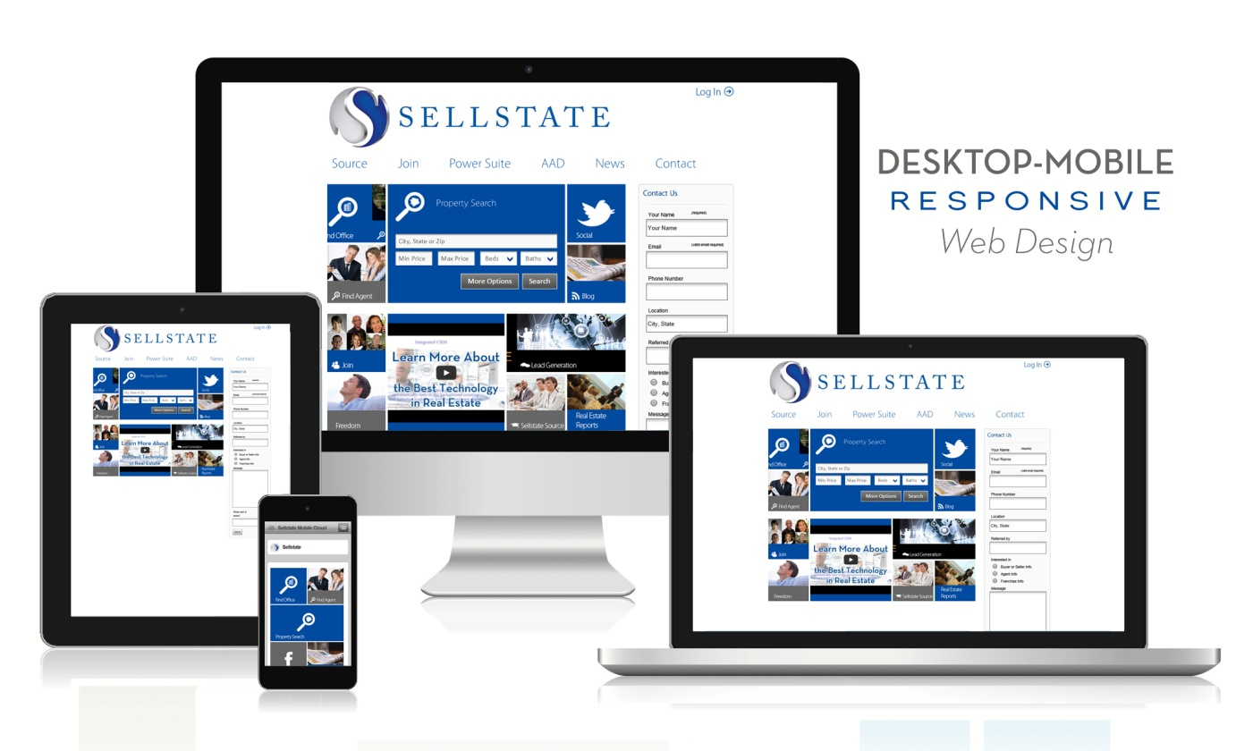
Sellstate.com
Real Estate’s First Touch Optimized Corporate Site
Touch optimized
The Sellstate Hub
Focused on user experience

Slide 22
Higher Education
Taking Pride in Making You Better
Education is a top priority
Constantly modified and improved
Focus on increasing business for our Advisors
Specific programs for new agents all the way to top mega producers

Slide 23
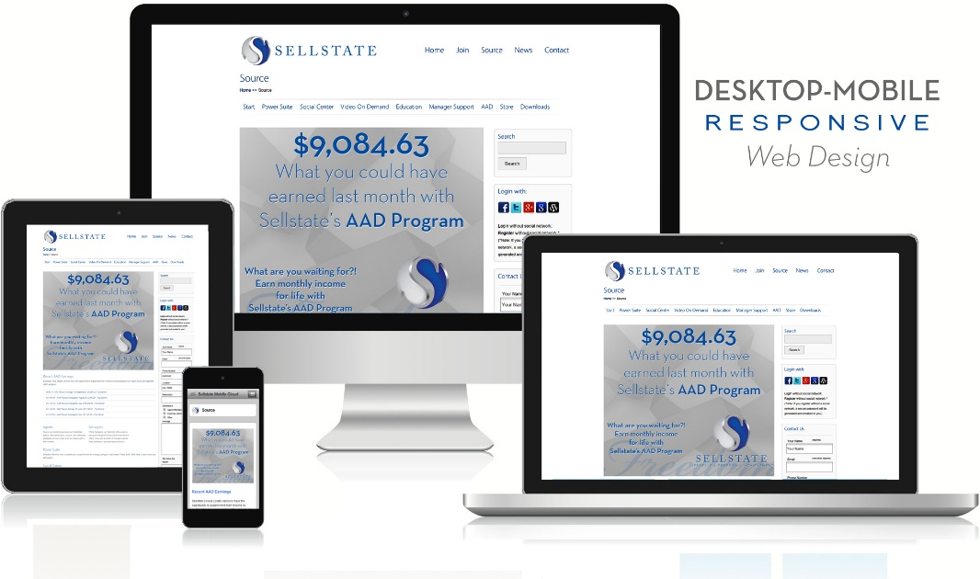
Sellstate Source
Sellstate Resources 24/7
Ever evolving online resource
Great user experience
Part of the Sellstate Mobile Cloud

Slide 24
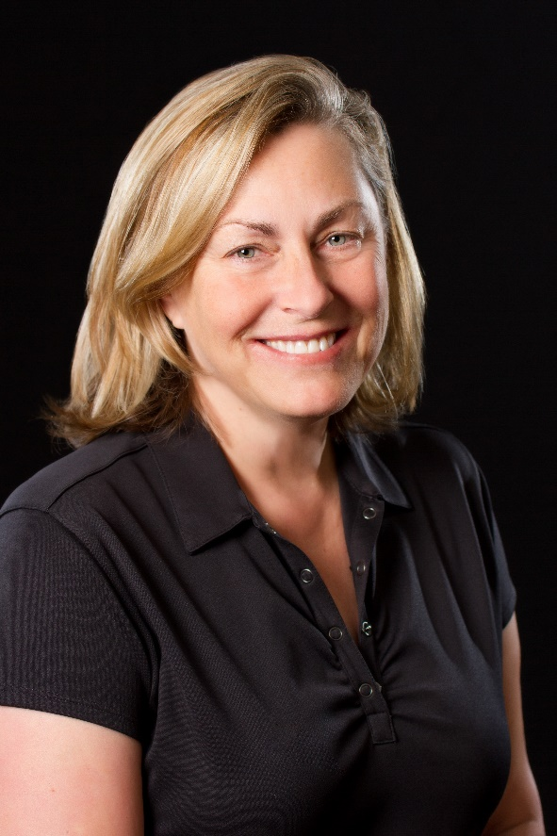
The Sellstate Industry Leaders Conference
Taking The Industry’s Best to New Heights
Conference exclusive to top performers
Custom programs to elevate top producers
Nothing like it in the industry
“I’m one of the top agents in my market place having closed over 100 transactions last year. After the Sellstate Industry Leaders Conference, I’m confident that I will be able to double my numbers while improving my quality of life. Without Sellstate, this would not be possible!”
- Deborah Sumey, Industry Leader

Slide 25
Corporate support
It’s Your Business, You Just Need The Tools
Technology
Education
Conferences
AAD
Agent empowerment

Slide 26
Broker Support
Onsite Dedication to Your Business
Dedicated team
Educational weekly meetings
Support with deals
Coaching
Technology training

Slide 27
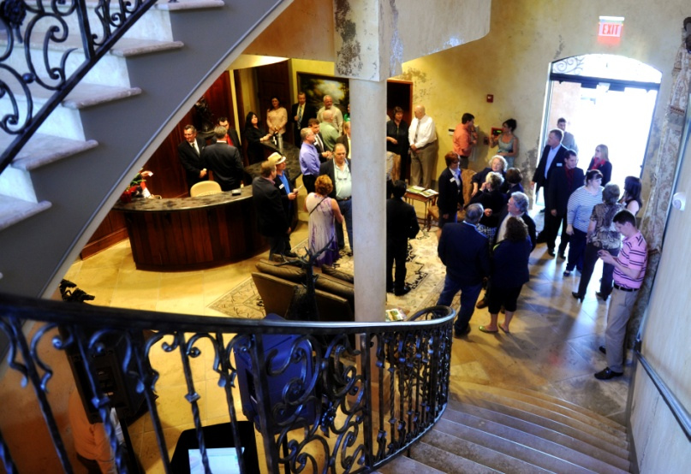
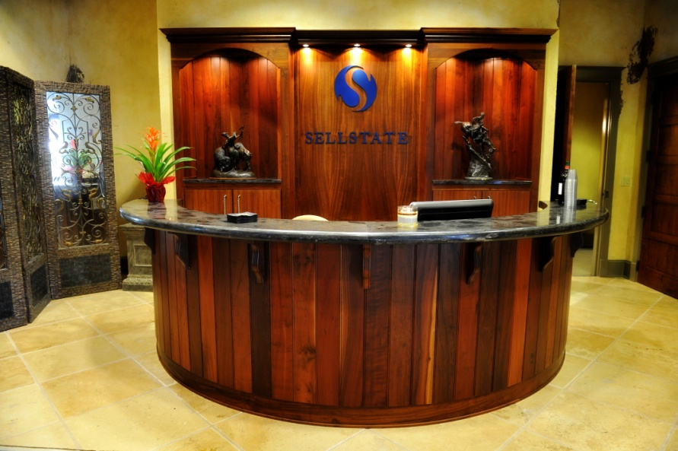
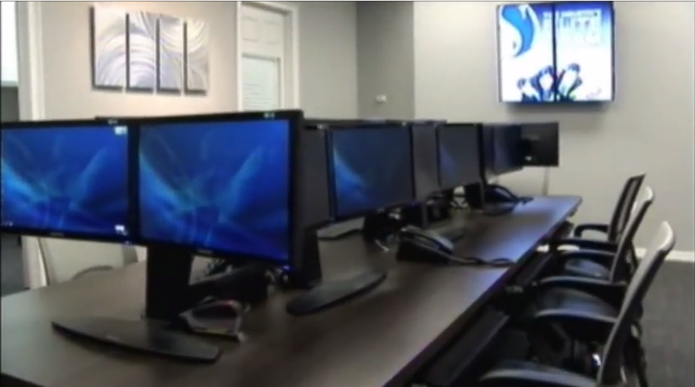
Office Image
Professional Workspace
Efficient layout
Technology
Multiple client rooms
Strong administration
Proud environment

Slide 28
Culture of Success
We Don’t Apologize For Being The Best
Strong culture
Community involvement
Better agents
Office engagement
Better environment

Slide 29
Aggressive Fee Structure
Getting You More For Less
2% Corporate Strategic Development Fund (goes towards building, expanding and supporting the business)
$[insert amount] per transaction
$[insert amount] per month
$165.38 annual fee (June 1st)

Slide 30
The Sellstate Pioneer Growth model
Leverage Your Business Through the Leadership of Others
Launch your franchise
Powerful leadership environment
Attracts the top agents
Improves culture
Empowers industry leaders

Slide 31
The Sellstate Pioneer growth Model
The Perfect Catalyst for Your Business
Owner
Pioneers
70%
30%
5%
5%
5%
5%
5%
5%

Slide 32
The Winning Formula
Lifestyle | Freedom | Achievement
Aggressive commission structure
5% Passive Income through AAD
Best technology including Sellstate Power Suite, C.P. Technology, etc.
Strongest lead generation through Sellstate Power Suite
Excellent office environment
Excellent office culture
Excellent training and support
Top agents attracting top agents

Slide 33
thank you
presenter
email
Presenter Name
Presenter Email Addresses
We Don’t Apologize for Being the Best

