Slide 1


Slide 2

What is Zillow?
Zillow is a home and real estate marketplace.
  Zillow helps consumers and industry professionals find and share vital information about homes, real estate, mortgages, and home improvement.
Zillow is a media and technology company.
Zillow helps consumers inform their home search through its living database of more than 110 million homes. It also provides marketing and advertising solutions for home-related professionals.
Zillow is not a brokerage or franchise.

Slide 3
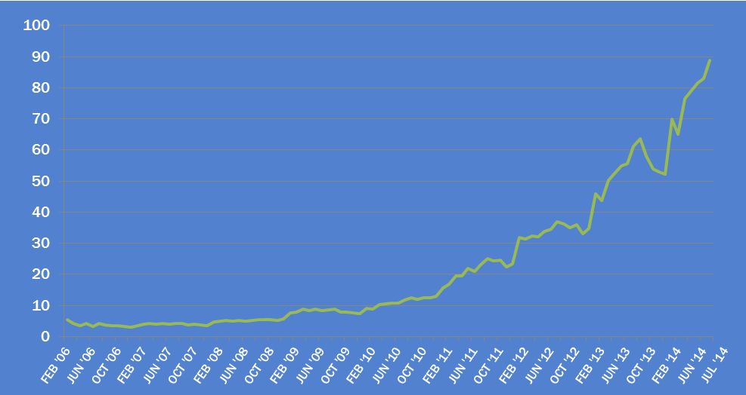
Opportunity.
Your listings appear on the Yahoo-Zillow Real Estate Network – the largest on the Web.¹
Monthly Unique Users²
Millions
JUL 2014
89 million
Sources: ¹comScore Media Metrix Real Estate Category Ranking by Unique Visitors, July 2014, US Data; ²Internal tracking via Google Analytics, July 2014

Slide 4
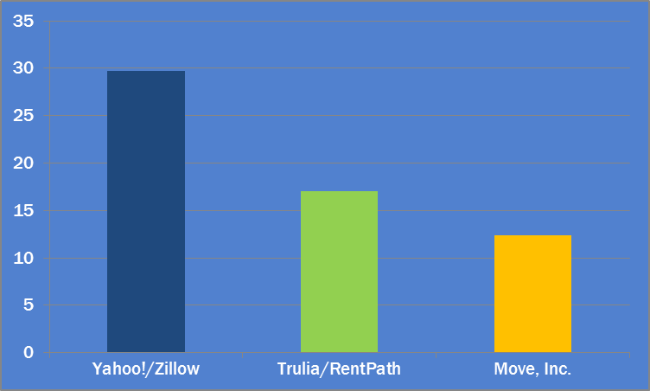
Reach.
On desktop, Zillow is nearly twice the size of Trulia and Realtor.com.
Monthly Unique Users, Desktop
Millions
Source: comScore Media Metrix, June 2014

Slide 5
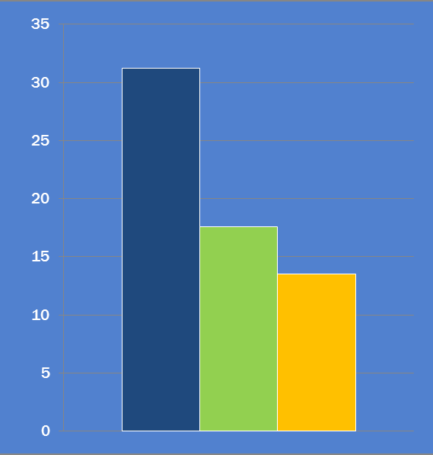
Exposure.
In addition to Zillow, your listings appear on Zillow Mobile – the most popular suite of mobile real estate apps across all major platforms.¹
Monthly unique users, mobile²
Millions
ZILLOW MOBILE FACTS:
Yahoo/Zillow
Zillow has more than two dozen apps across all major platforms.
Trulia/RentPath
+44%
+57%
Move, Inc.
In July, half a billion homes were viewed on Zillow Mobile – that’s 212 homes per second!³
Two-thirds of Zillow’s visits come from a mobile device; on weekends it’s more than 70%.³
¹Zillow Internal, June 2014
²comScore Mobile Metrix Key Measures, June 2014
³Google Analytics, July 2014

Slide 6





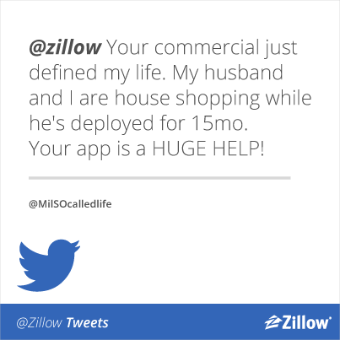

Commitment.
Zillow will keep investing to bring the largest audience of consumers to you.
PARTNERSHIPS
CONSUMER ADVERTISING
Home search through

Slide 7
Sellstate Realty Partnership

Slide 8
What is Zillow Pro for Brokers?
Zillow Pro for Brokers is a partnership that focuses on two areas:
Data accuracy
Integrating with the most accurate source of data so real estate professionals and consumers are connecting through the most up-to-date information available
Listing agent prioritization
Giving listing agents what is rightfully theirs – a spotlight on their name for their listing in front of the largest audience of buyers and sellers on the Web
Source: comScore Media Metrix Real Estate Category Ranking by Unique Visitors, December 2013

Slide 9
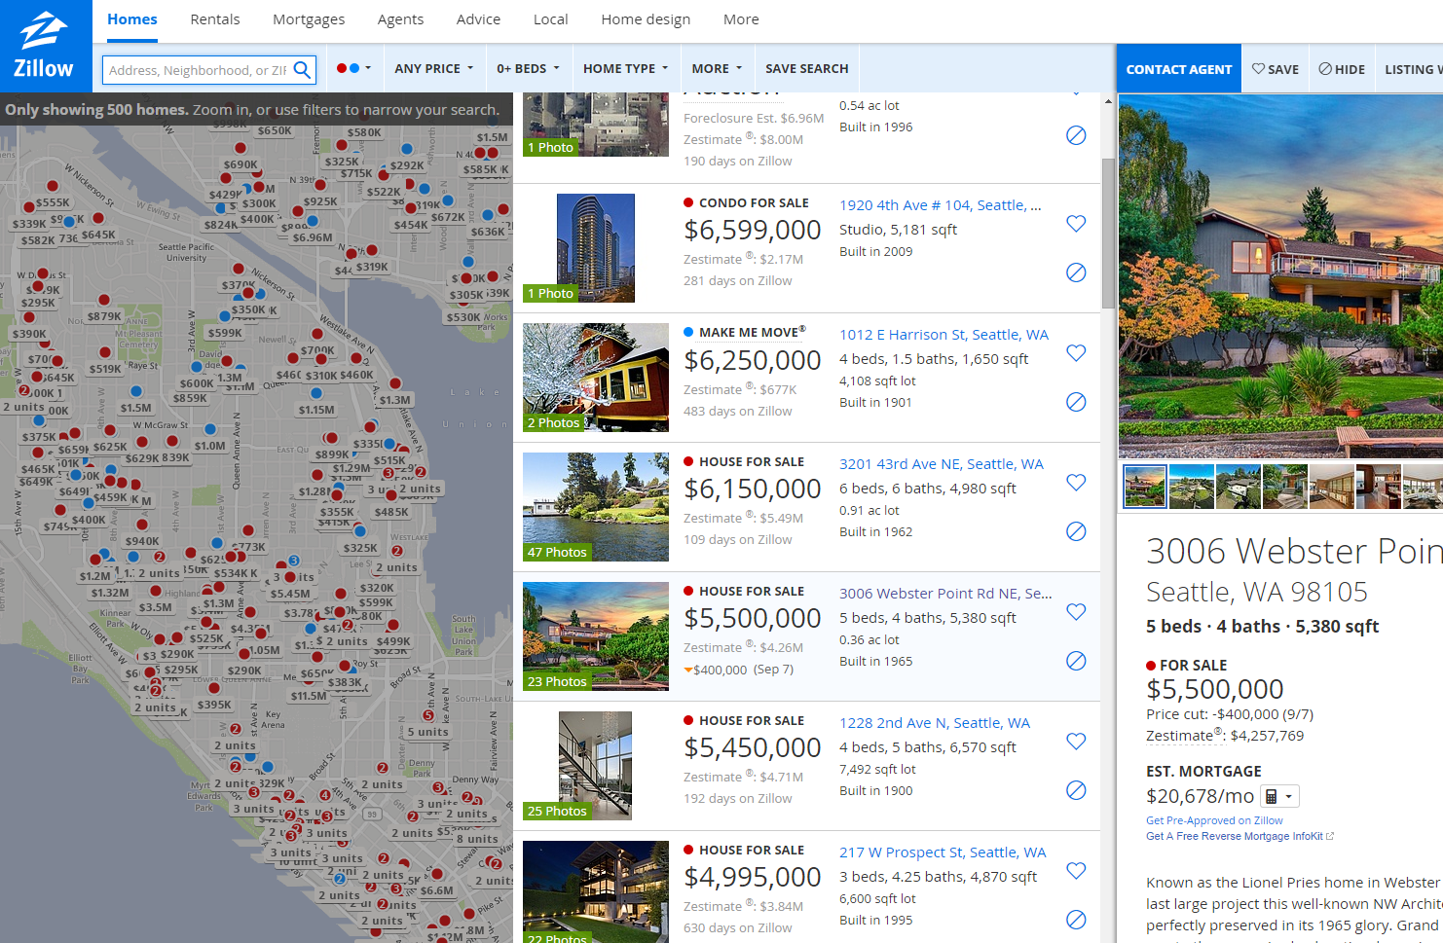
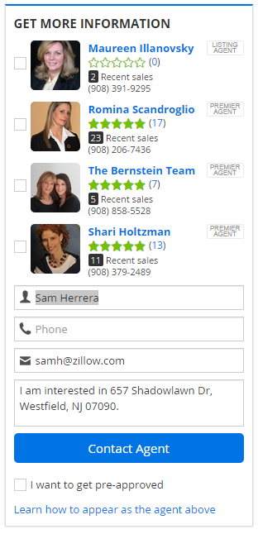

Zillow Pro for Brokers helps your listing agents connect with buyers.
Activates listing agents automatically
and gives listing agents the most prominent position
Keeps data accurate and leads fresh
to keep agents and buyers on the same page
Agents receive leads immediately upon activation

Slide 10

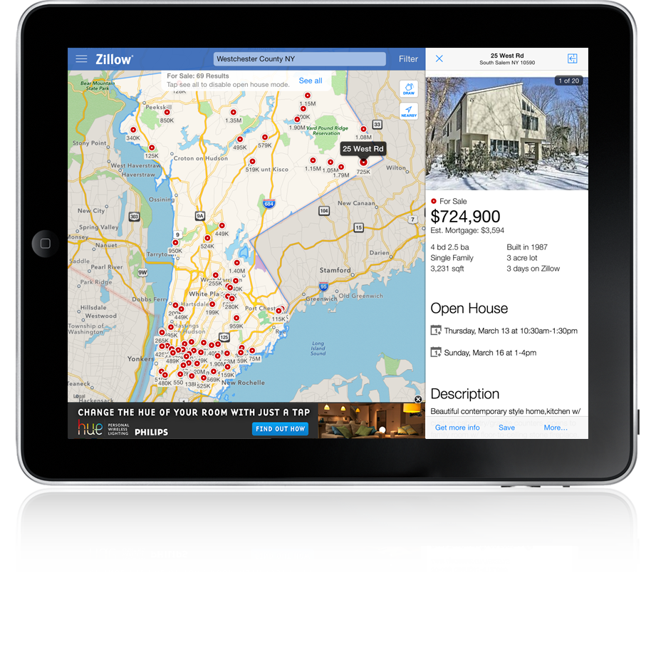

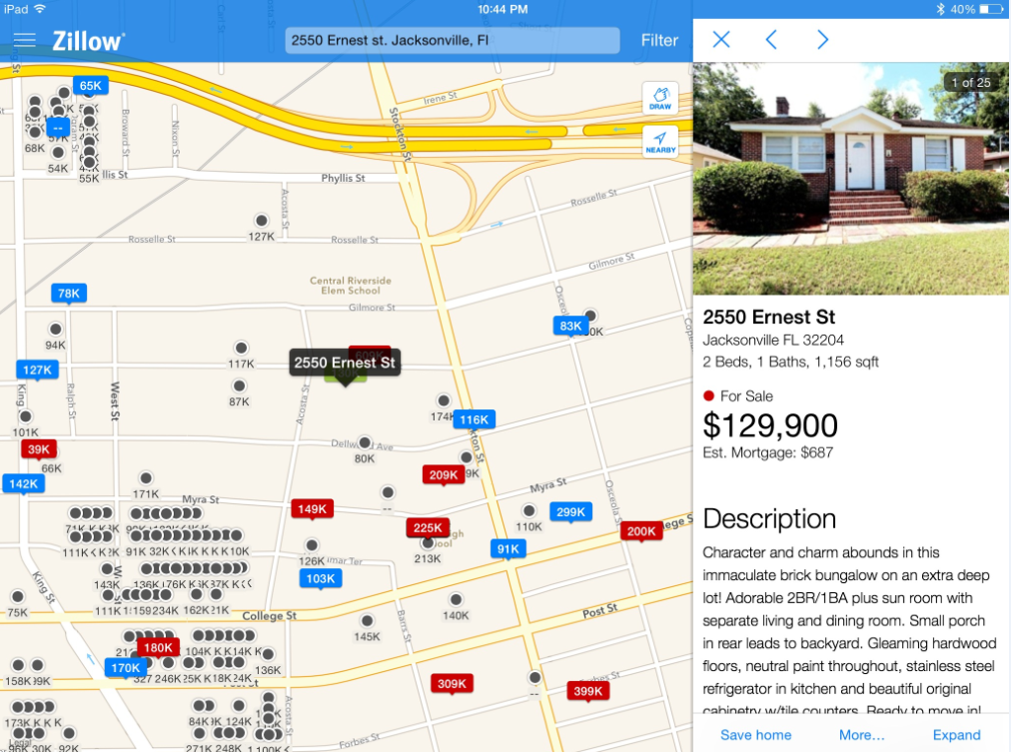
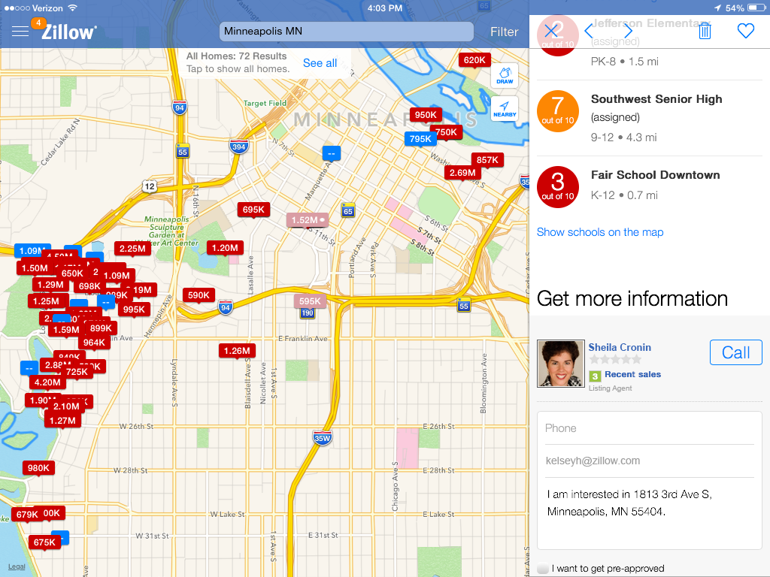
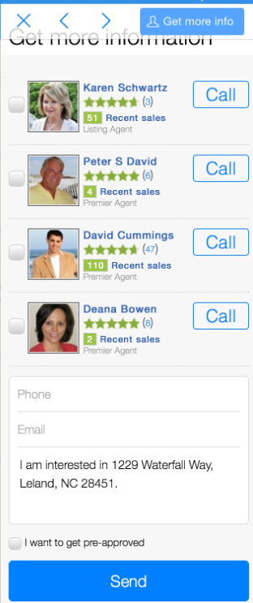
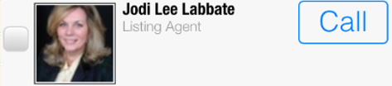
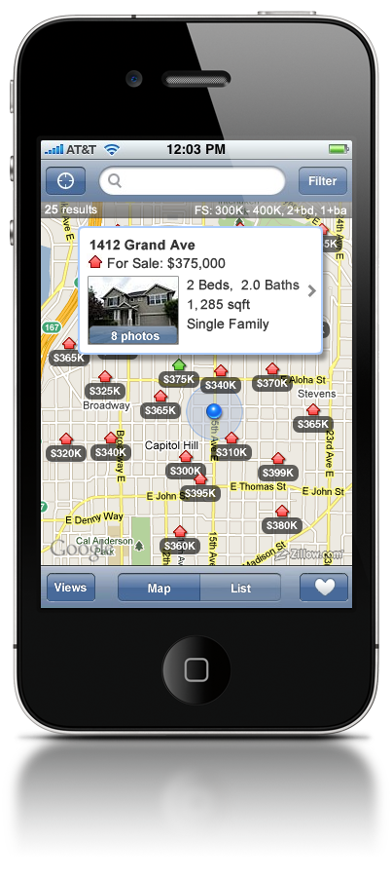
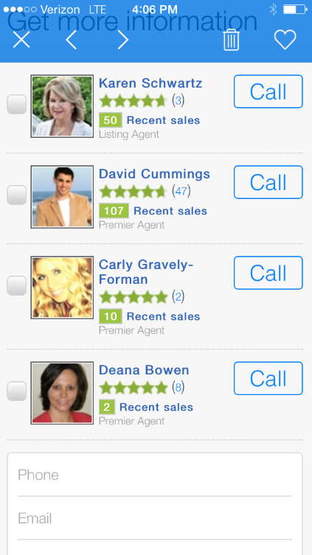
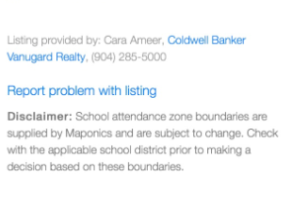

Zillow Pro For Brokers: Mobile
Mobile Contact Form
The listing agent is the first choice, prominently displayed, clearly identified.
Two-thirds of Zillow’s visits come from a mobile device; on weekends it’s more than 70%.³
¹Zillow Internal, May 2014
²Experian Marketing Services via Inman News, 11/25/2013
³Google Analytics, May 2014

Slide 11
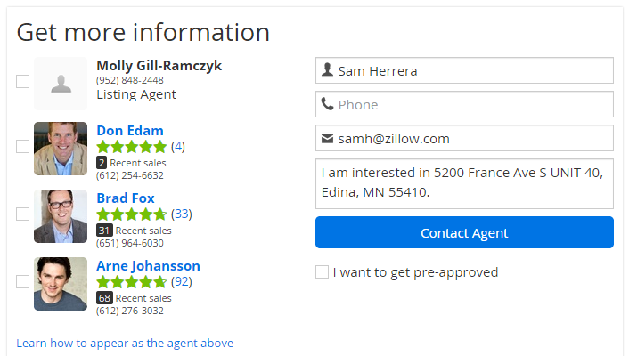


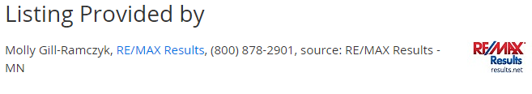

Zillow Pro for Brokers helps your brokerage get more business.
Features your logo and an outbound link to your website
so buyers and sellers can connect with your agents directly
Makes you the authentic owner of the data
so you control how your listings appear on Zillow
Sellstate Realty
Zillow helps your brokerage stand out to buyers and sellers
Sellstate Realty

Slide 12
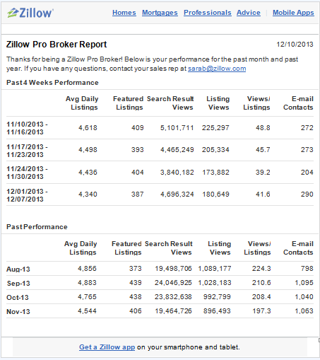
Zillow Pro for Brokers helps you work smarter.
Helps you monitor success with weekly activity reports
so you can track listing quantity, traffic, and contact rates
Helps attract and retain high-performing agents
who want to join a brokerage with proof of results
Track key metrics weekly and monthly to show what’s working and what’s not – fast.

Slide 13
Next Steps?

Slide 14
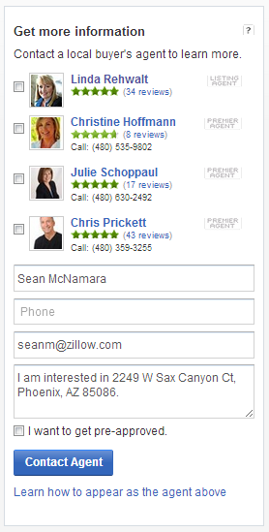
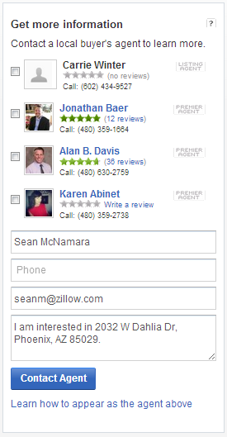
Profile/Reviews – Complete to Maximize Contacts
Completed Profiles with 5+ Reviews Receive 150% More Contacts on Average
Checklist:
Create Free Profile
Upload Photo
Complete Bio
Request Reviews
Upload Past Sales
For more info and help videos visit Zillow Agent Help Center: http://www.zillow.com/help/agents/

Slide 15

SellState Realty Discounts – Premier Agent
Discounts on the initial purchase of the Zillow Premier Agent Program:
  5% on a 6 month contract, paid monthly
  10% on a 6 month contract, paid upfront in full
  20% on a 12 month contract, paid monthly
  30% on a 12 month contract, paid upfront in full

